Slide 1
Case Study 1 – Exploratory Data Analysis
Prepared by Andrew Yule, John Worrall, and Andrew Walch

Slide 2
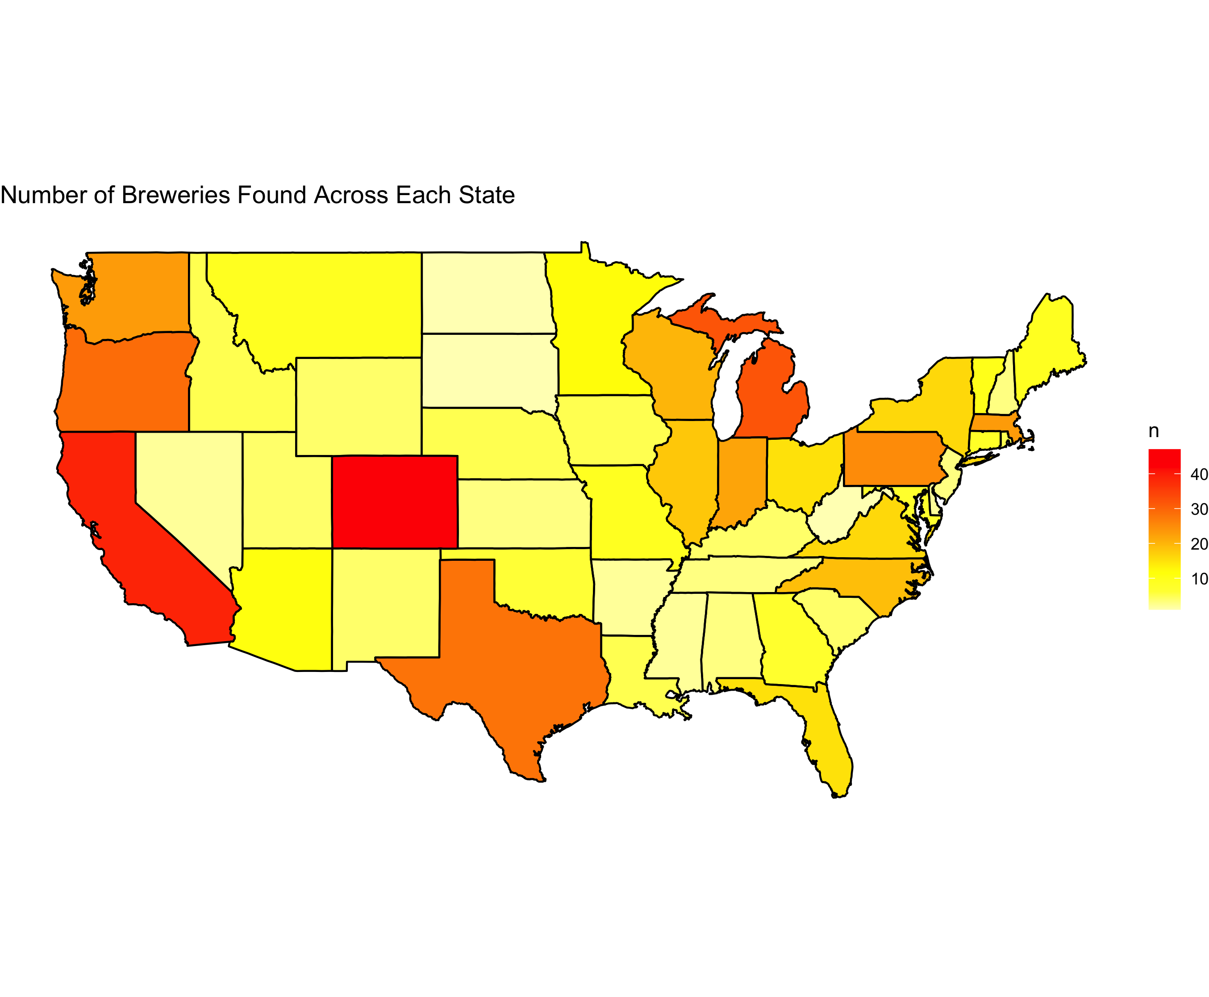
Breweries Present in Each State
Top 5 states:
Colorado (47)
California (39)
Michigan (32)
Oregon (29)
Texas (28)
Bottom 5 states:
DC (1)
North Dakota (1)
South Dakota (1)
West Virginia (1)
Arkansas (2)
Top 5 make up 32 % of all breweries

Slide 3
Key Missing Values
International bitterness unit (IBV) is unreported for 42% of the data
Percentage of Data Missing for Given Category
Beer | Beer_ID | ABV | IBU | Brewery_ID | Style | Ounces | Brewery | City | State
0% | 0% | 2.6% | 42% | 0% | 0.2% | 0% | 0% | 0% | 0%

Slide 4
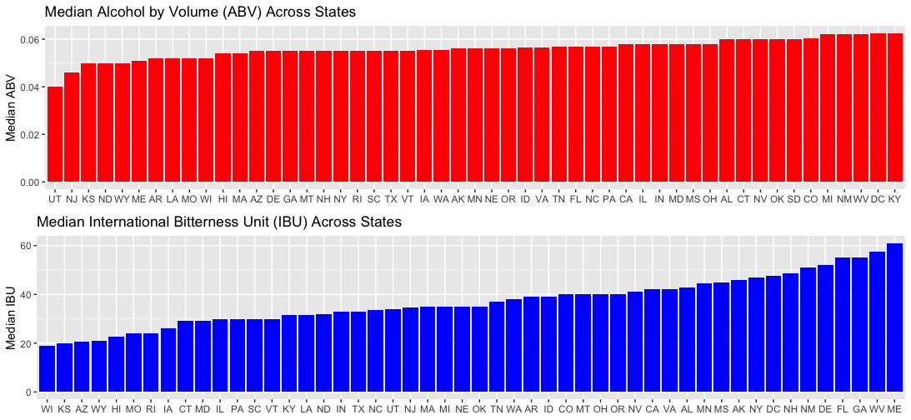
Median ABV and IBU by State
Median ABV
Min = 0.04
Max = 0.0625
Median IBU
Min = 19
Max = 61

Slide 5
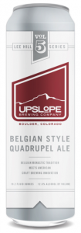

Maximum ABV and IBU
Max Overall ABV
Lee Hill Series Vol. 5 - Belgian Style Quadrupel Ale
Upslope Brewing Company
Colorado
ABV = 0.128
Max Overall IBU
Bitter B*tch Imperial IPA
Astoria Brewing Company
Oregon
IBU = 138

Slide 6
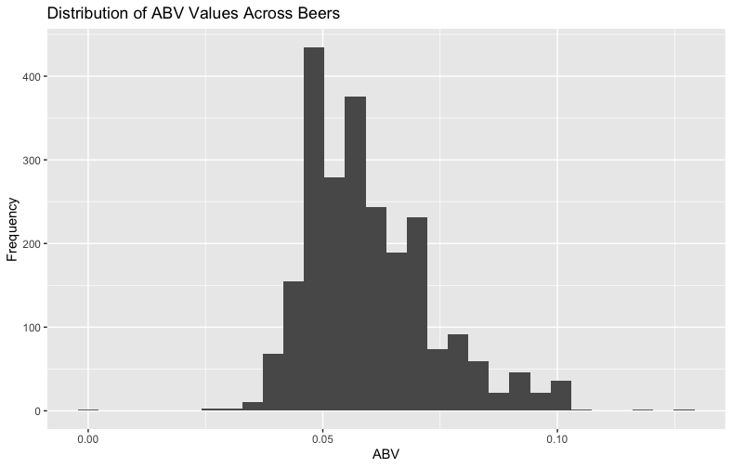
Distribution of ABV
Parameter | Value
Minimum | 0.001
1st Quartile | 0.050
Median | 0.056
Mean | 0.059
3rd Quartile | 0.067
Max | 0.128
Distribution is right skewed
The distribution of ABV is right skewed, meaning there are a few beers with very high alcohol contents increasing the mean ABV compared to the median ABV.

